Slide 1
QVC Fulfillment-Does Speed Matter in E-Commerce?
Presented by: Evan Canfield, Khabirul Gainey, Joshua Ganz, Jake Hoertt, Julian Mucha, Harika Mudigonda

Slide 2
Agenda/Outline
Background
Data Processing
Exploratory Data Analysis
Questions
1. Does the current distribution network maximize customer penetration (spend)? If not, what
should QVC do to increase customer penetration with the current distribution network?
2. Are there specific products or product categories that should be located in specific
distribution centers?
3. Do customers that receive their product sooner purchase more than customers with longer
delivery times?
Results Summary
Conclusion
Improvements for next time
Takeaways/ questions
Notes:
Khabirul

Slide 3
Background
Our goal is to examine QVC’s customer geography, distribution network, product mix, and purchase patterns to
help QVC understand the relationship between speed of product/package delivery and customer loyalty.
Data
QVC Sales Data
Three large spreadsheets (named QVC Data 1, 2, 3), each with just under 1 million rows
Distribution Center Data
Warehouse ID, City, State, Cip Code
Order Status Type
Data Dictionary
Notes:
Dataset details, summary stats on data set provided - Khabirul

Slide 4
Derived Variables
Rescheduled
Binary based on Rescheduled Date
Distance
Haversine method via latitude and longitude of origin and destination
Fulfillment Time
From Order date to Delivery date
Notes:
Khabirul

Slide 5
Question 1
Does the current distribution network maximize customer penetration (spend)? If not, what should QVC do to increase customer penetration with the current distribution network?

Slide 6
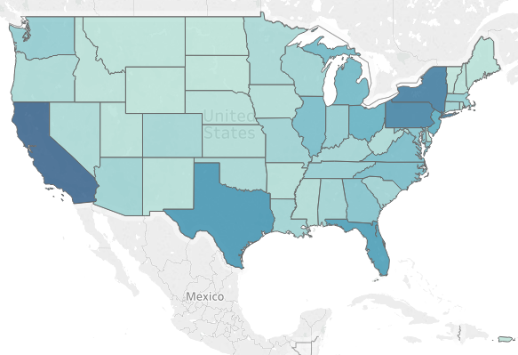
Sales By State

Slide 7
Top 5 States By Sales
California
New York
Pennsylvania
Texas
Florida

Slide 8
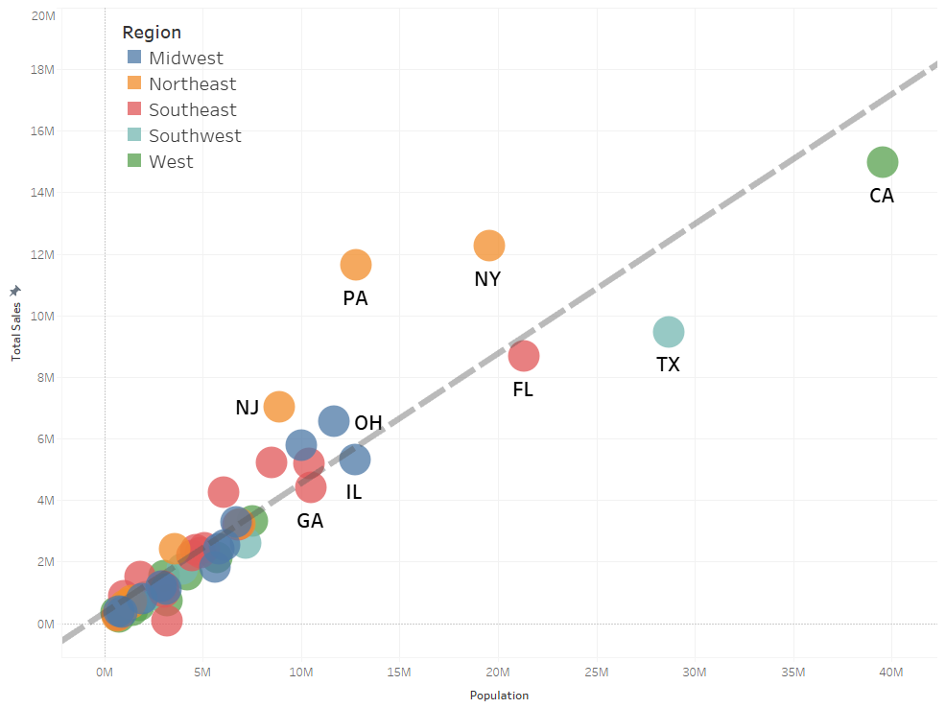
Total Sales vs State Population
Notes:
R2 0.85
Linear Regression > coefficient statistically significant (0.42)

Slide 9
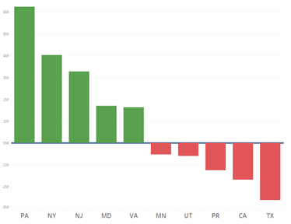
Total Sales vs Baseline Expectation

Slide 10
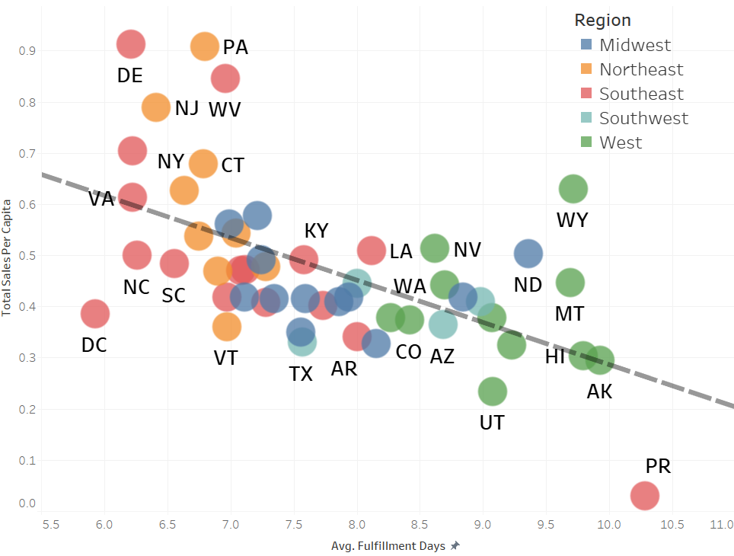
Sales per Capita vs Fulfillment Days

Slide 11
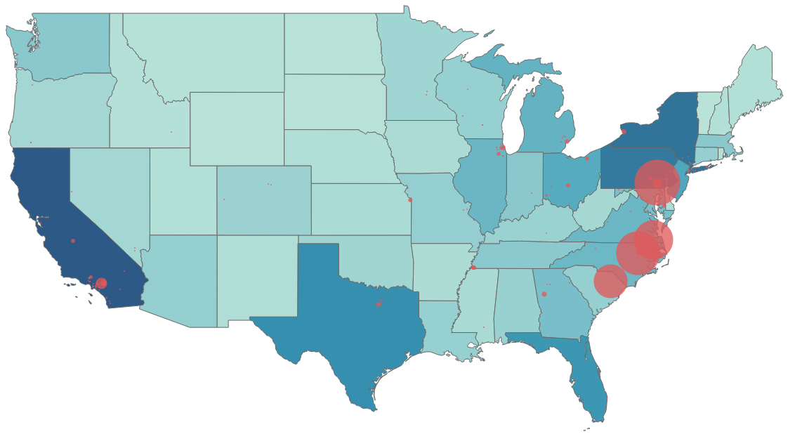
Shipping Warehouse Locations
91.2% of all sales are shipped from four Distribution Centers.
Located in PA, NC , SC, VA
Largest Distribution Center in Texas handles 0.31% of all sales in the country
Largest Distribution Center in California handles 1.7% of all sales in the country

Slide 12
Question 1 Breakdown
The State Sales - Population is linear, and provides the baseline performance expectation for each state
Some states over perform (Pennsylvania, New York) while other states under perform (Texas, California)
Under performance is correlated with longer order fulfillment times
Currently 91.2% of all shipping capacity comes out of four warehouses, all on the East Coast
Recommend: Expand or construct new warehouses in Texas, California, and Florida to reduce shipping times to these and surrounding states.

Slide 13
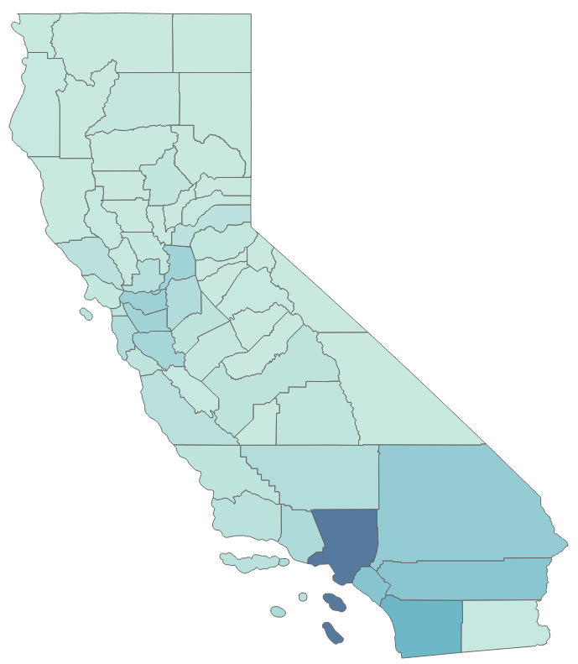
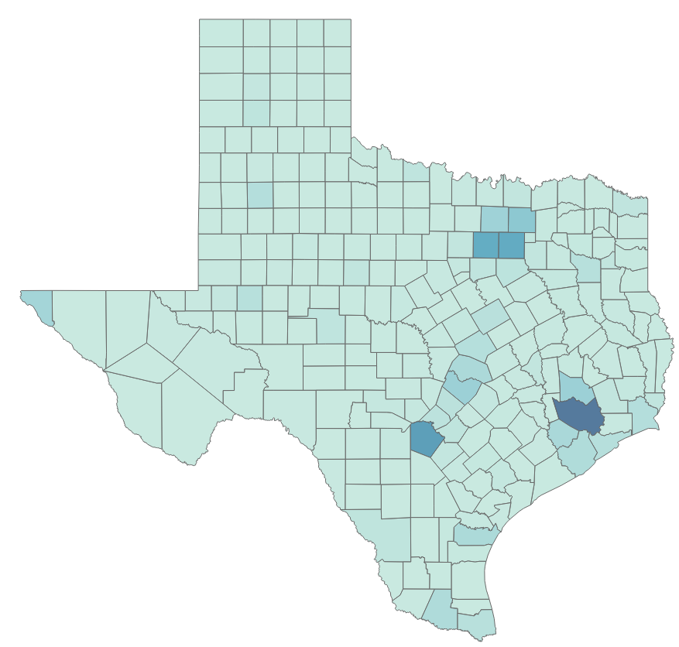
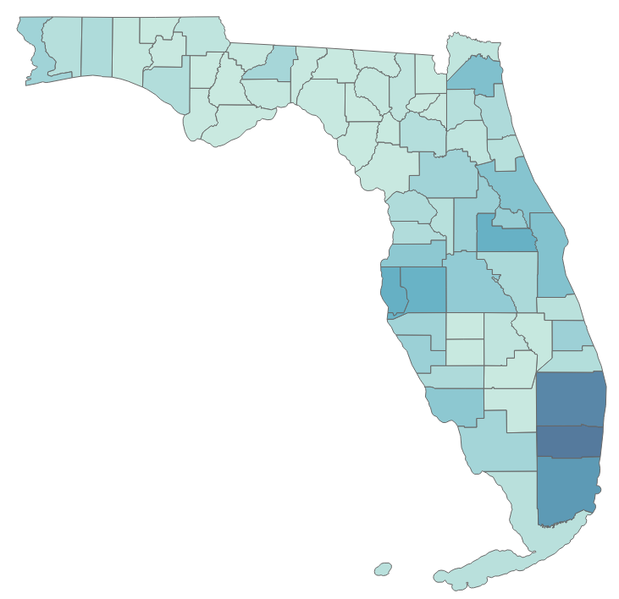
Possible Distribution Center Locations
California
Texas
Florida

Slide 14
Question 2
Are there specific products or product categories that should be located in specific distribution centers?
Notes:
Harika

Slide 15
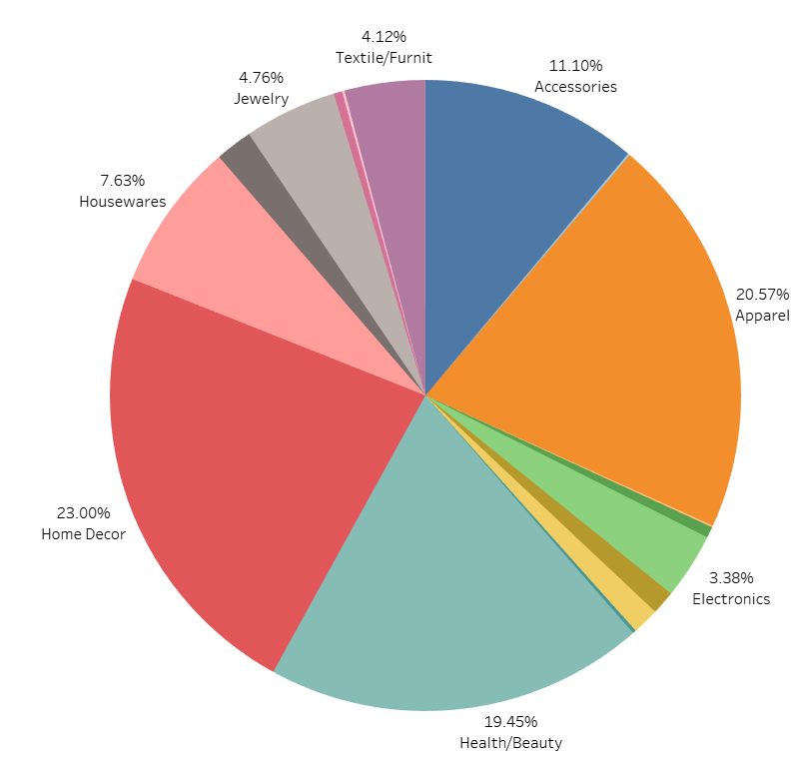
Product Categories Based on Products Shipped to CA
Top Product Categories
Apparel | 20.57%
Health/Beauty | 19.45%
Home Decor | 23.00%
Housewares | 7.63%
Total | 70.65%
Notes:
Harika

Slide 16
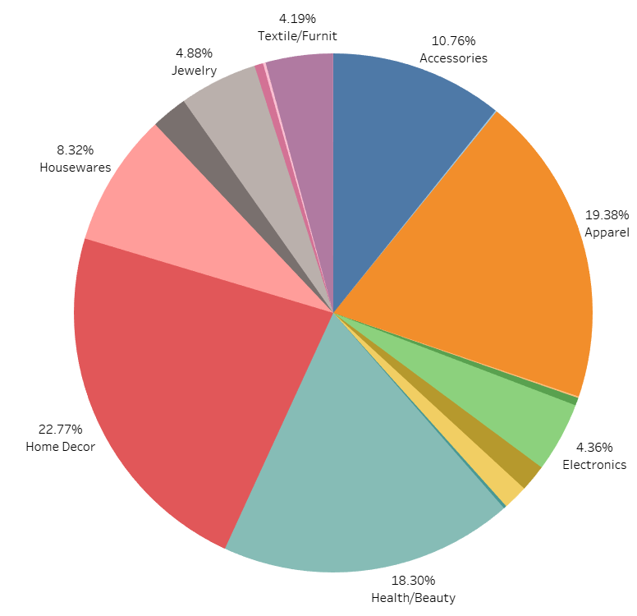
Product Categories Based on Products Shipped to TX
Top Product Categories
Apparel | 19.38%
Health/Beauty | 18.30%
Home Decor | 22.77%
Housewares | 8.32%
Total | 68.77%
Notes:
Harika

Slide 17
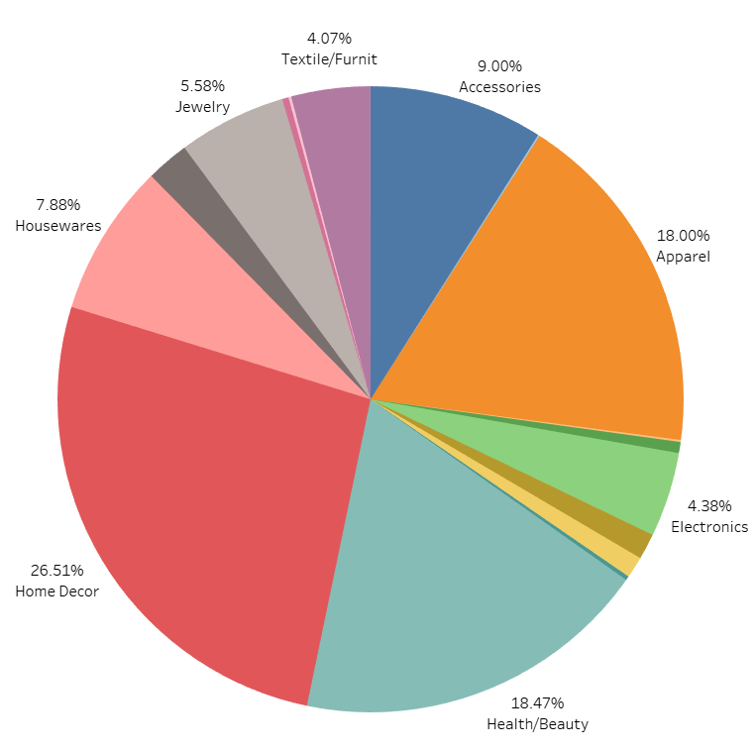
Product Categories Based on Products Shipped to FL
Top Product Categories
Apparel | 18.00%
Health/Beauty | 18.47%
Home Decor | 26.51%
Housewares | 7.88%
Total | 70.86%
Notes:
Harika

Slide 18
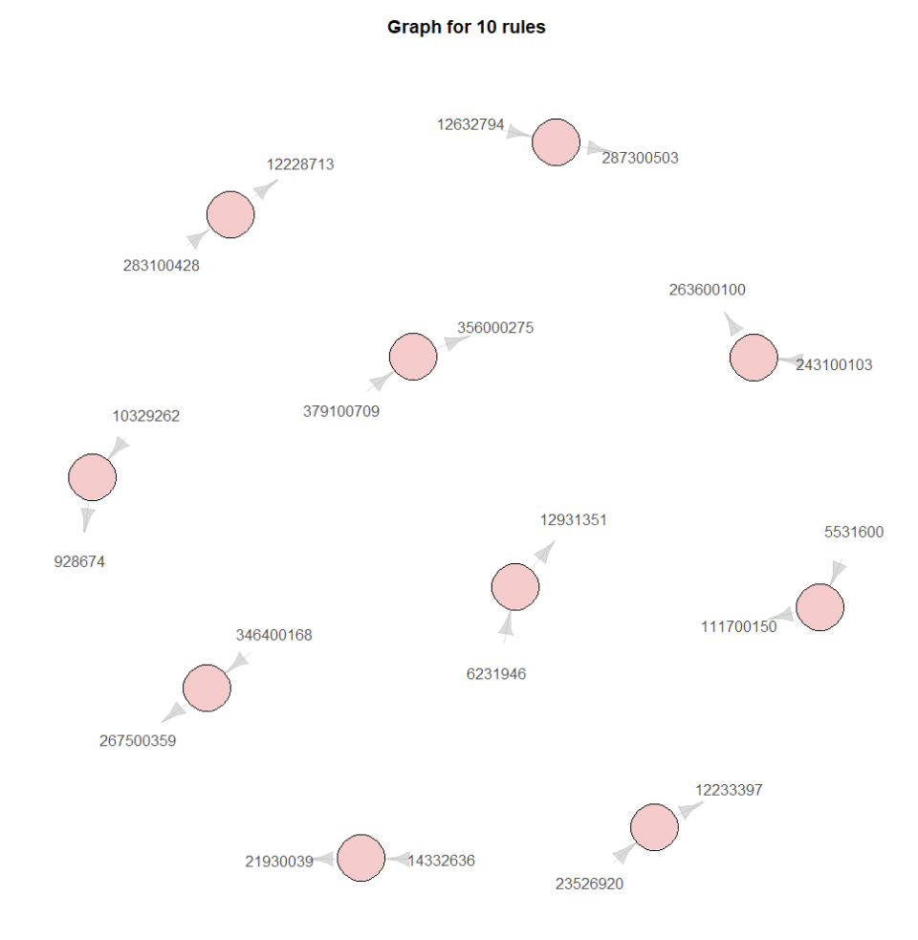
Association Rule Mining
Top Ten Rules By Lift
Association Rule Mining revealed the following :
611 unique rules
Five frequent sets of two
Very low support threshold required to generate any rules or sets
All rules were based on unique pairs
Notes:
Josh

Slide 19
Question 2 Breakdown
Roughly 70% of sales in each state fall under the same four categories
Apparel
Health/Beauty
Home Decor
Housewares
Stock local distribution centers
Majority of products from the four mentioned categories
Goal of decreasing fulfillment time
Notes:
Josh

Slide 20
Question 3
Do customers that receive their product
sooner purchase more than customers with
longer delivery times?
Notes:
Jake

Slide 21
Target Variable Creation
Create Repeat Customer labels
Filter down to first-order
Final Dataset with targets
Perform group by Party ID and count number of orders.
Tag customers who made more than 1 order as repeat customers.
To ensure a fair model evaluation of identifying repeat customers, we must only use customers’ first orders to train our model.
Our result is a customer level dataset with each row representing their first order, and a binary label indicating if they are a repeat customer.
Repeat Customer?
Notes:
Jake

Slide 22
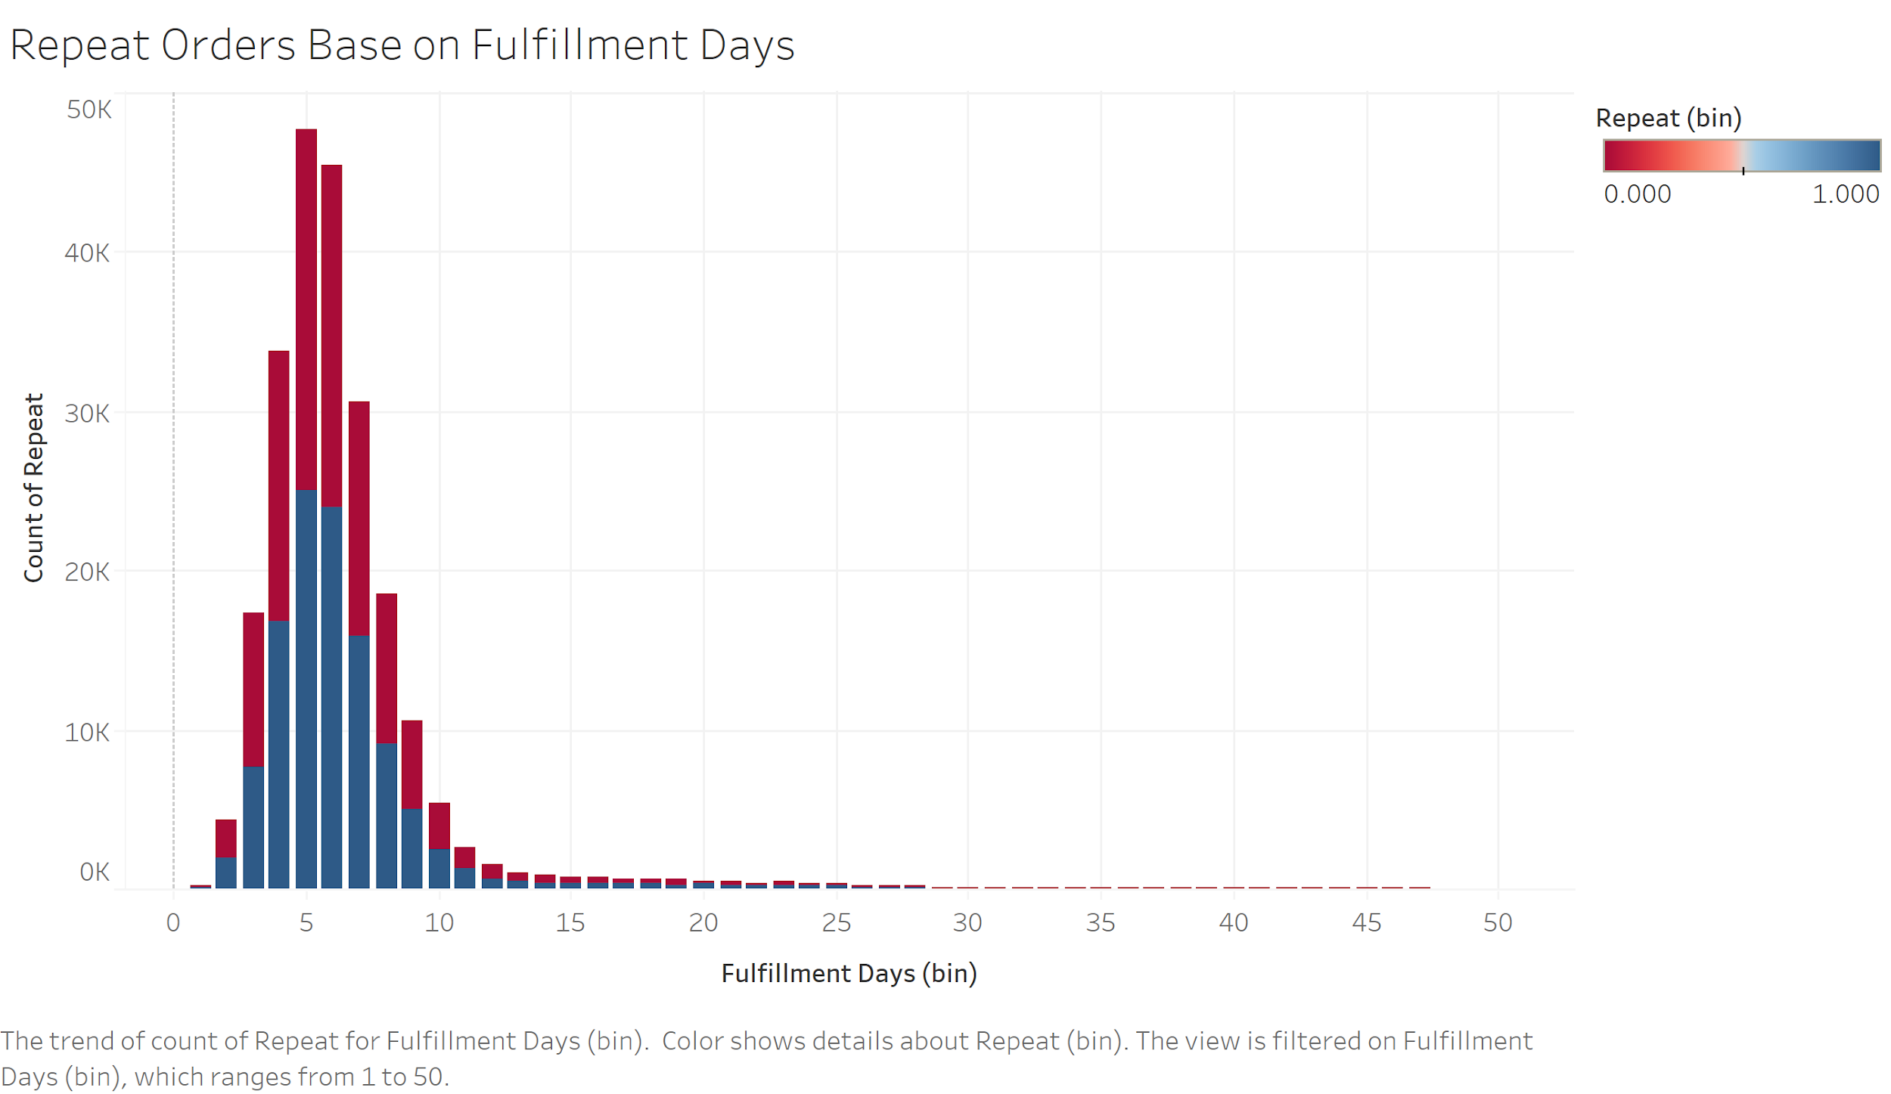
Repeat Customers Based on Fulfillment Days
Notes:
Jake

Slide 23
Model Approach
Logistic Regression
Random Forest
Examine confusion matrix
Identify if there is statistical significance with variables related to order fulfillment time
Examine confusion matrix
Identify influential variables in variable importance plots
Less interpretable results, but more insight into feature set
Notes:
Jake

Slide 24
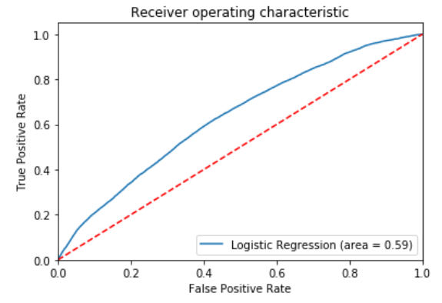
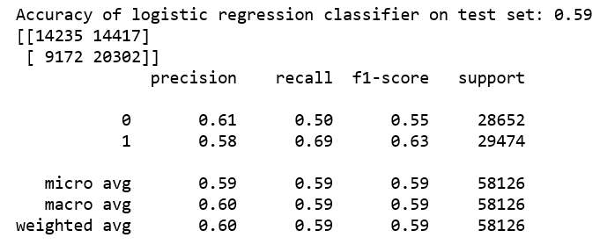
Logistic Regression
Notes:
Julian

Slide 25
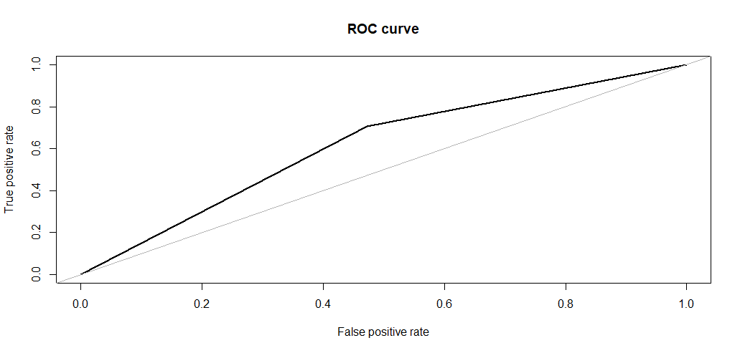
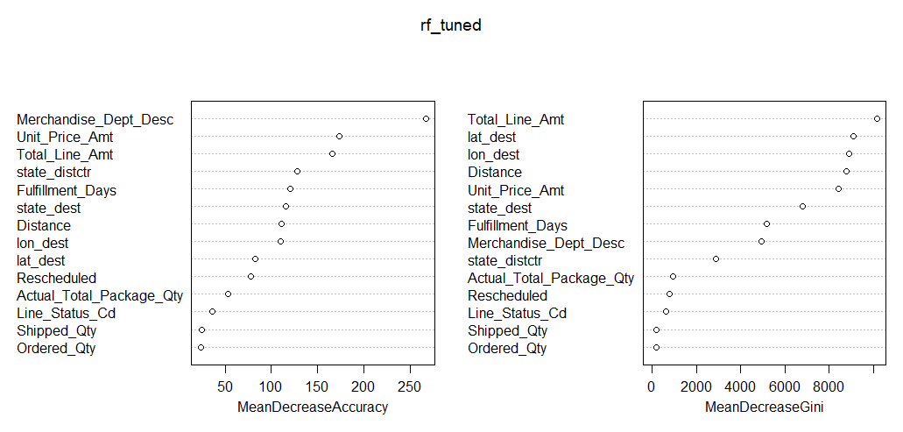
Random Forest
Tuned Model
1000 trees
3 variables selected for each tree
AUC: 0.616
Fulfillment Days is a top 7 variable in both variable importance plots, but we observe that total price paid by customer is ranked higher in each plot.
Notes:
Julian

Slide 26
Question 3 Breakdown
Unit price paid and Total price paid are more impactful than fulfillment days in determining repeat customers.
Having to reschedule an order made a customer less likely to be a repeat customer.
Distance and fulfillment days are related to each other.
Notes:
Julian

Slide 27
Results Summary
Question 1: Does the current distribution network maximize customer penetration (spend)? If not, what should QVC do to increase customer penetration with the current distribution network?
The current distribution network does not maximize customer penetration
QVC should build, or expand existing, distribution centers in California, Texas, and Florida to decrease order fulfillment times in these customer dense areas
Question 2: Are there specific products or product categories that should be located in specific distribution centers?
Local distribution centers in CA, TX, and FL should stock items in the apparel, health/beauty, home decor, and housewares categories since that is about 70% of the sales in each state
Question 3: Do customers that receive their product sooner purchase more than customers with longer delivery times?
The random forest suggests that fulfillment days is an important variable in predicting repeat customers, but price paid may play a larger role.
Notes:
K

Slide 28
Conclusion
Improvements for Next Time
More granular product data so we can provide more actionable insights regarding what products to stock at new and existing distribution centers.
Connect our classification models predicting repeat business to a customer loyalty program to push targeted advertising.
Better understand the relationship between company practices and data collection.
Perform market research and competitive analysis on similar companies.
Notes:
K

Slide 29
Questions?

Slide 30
Appendix

Slide 31
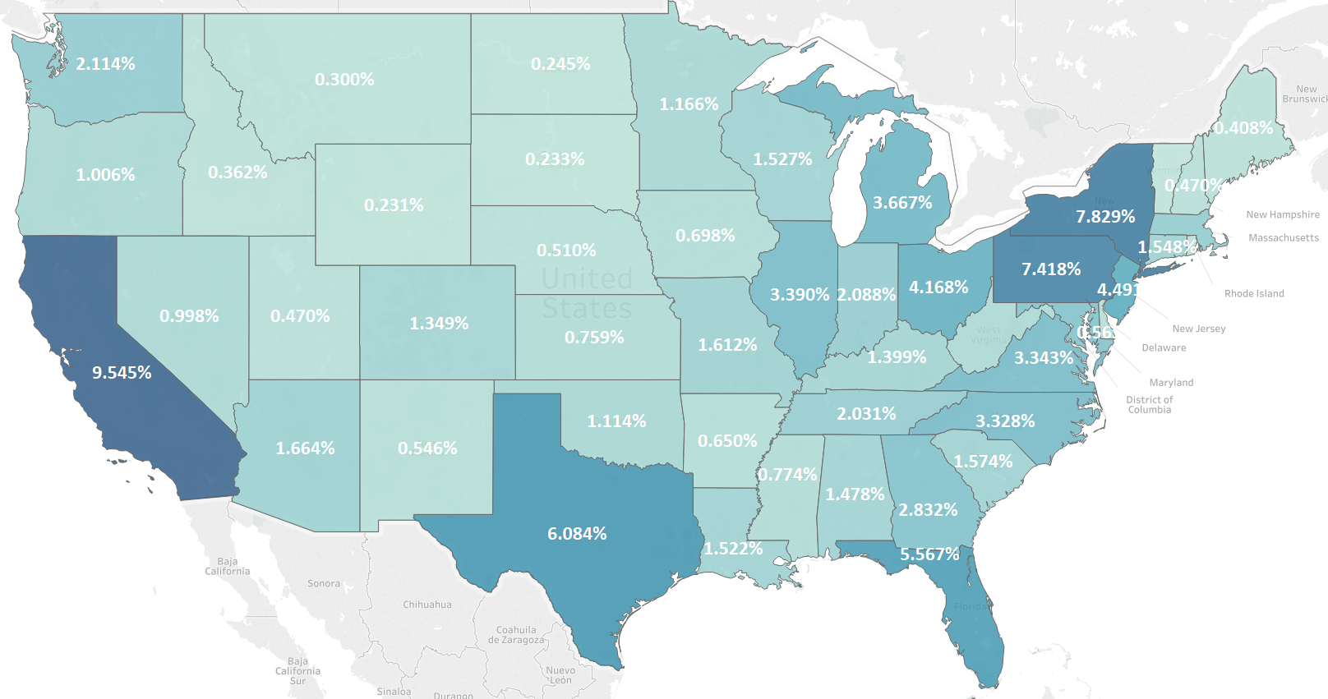
Sales By State

Slide 32
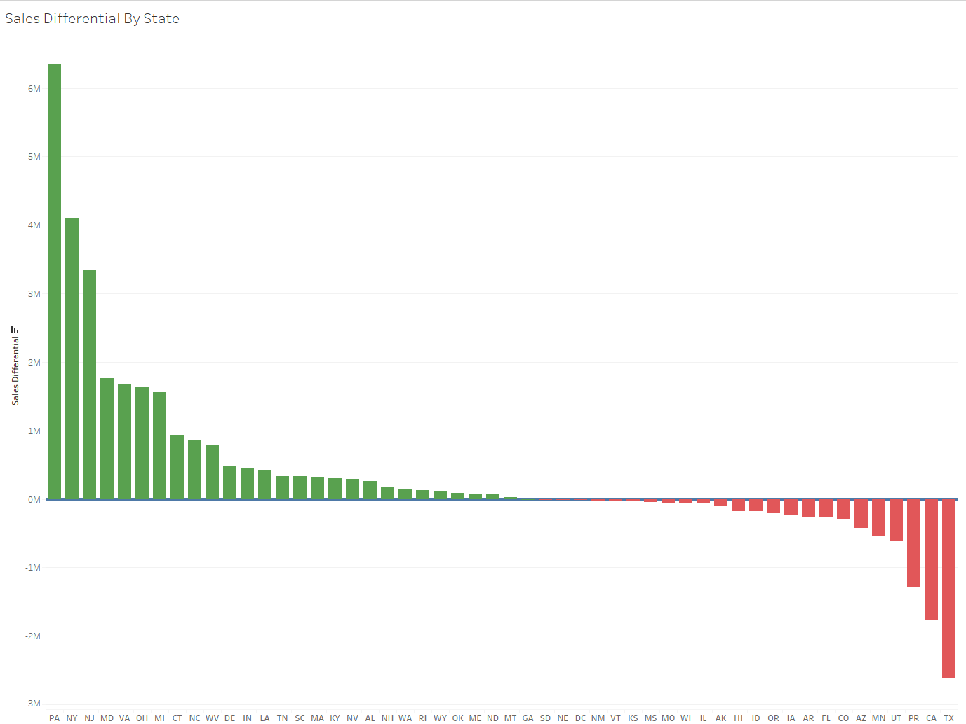
Total Sales vs Baseline Expectation

Slide 33
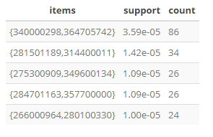
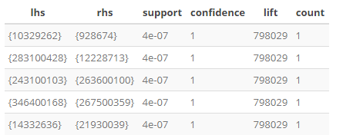
Association Rule Mining
Frequent Item Sets
Association Mining Rules

